Slide 1
2015/16 Korea-Bulgaria Knowledge Sharing Program
Building a Strategic Model for Sofia Tech Park’s Development: Strategic Issues and Planning Guidelines
Taeyoung Shin & Anna-Marie Vilamovska
Feb. 24, 2016
Ministry of Strategy and Finance of Korea
Korea Development Institute (KDI)
Sofia Tech Park Jsc

Slide 2
Table of Contents
Introduction
Theoretical backgrounds and development of S&T park
Korean experiences : S&T parks
Assessment of current state of Bulgaria’s innovation system and Sofia Tech Park
Guidelines for planning
Concluding remarks and policy suggestions

Slide 3
Introduction
KSP (Knowledge Sharing Program) between Korea and Bulgaria.
    KSP aims to share Korea’s development know-how, assisting the partner countries and working towards lessening the knowledge divide.
STP/TIN project of Bulgaria
    Initial request
        Strategic planning and operations,
        Facilities and infrastructure development,
        Business incubation, iv) technology transfer,
        Internalization, and others
    Agreement : “Strategic issues and planning guideline” for STP’s development
    Purposes of the study
        To provide policy advice to Bulgarian Government
        To assist harnessing innovation policy and developing the STP/TIN project, focusing on TBI

Slide 4
Theoretical Backgrounds

Slide 5
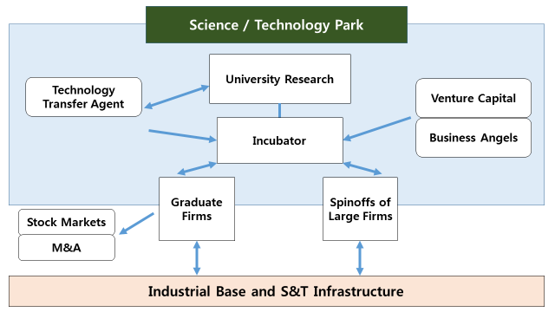
Continued.

Slide 6
Development of S&T Parks
Several cases
    Silicon Valley in USA
    Tsukuba Science City in Japan
    Sophia-Antipolis in Frnce
    Daedeok Science Town in Korea
Main factors for successful development
    Dedication and leadership of participants from universities and business (or government)
    Interaction between research organizations and industries in developing new technology-based business
    Sustained government policy creating STI-friendly environment including infrastructure and human resources.
    Developed NIS/RIS: increased STI inputs and outputs.
    Cultural/social backgrounds nurturing entrepreneurship

Slide 7
Continued.
Some factors are often pointed out when successful achievement is not exhibited.
    Strong dependence on government support which is not continued with a consistency
    Lack of innovation culture and resources; particularly entrepreneurship
    Lack of network of innovation units between universities, business and government
    Low STI capacity
    Underdeveloped industrial eco-system

Slide 8
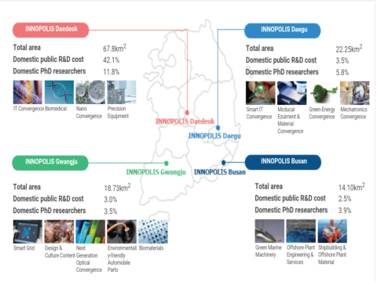
Korean Experience : S&T Parks

Slide 9
Continued.
The R&D Special Zone aims
    To grow towards an innovation cluster
    To foster development of technology-based startups.
This approach is pursued by the Ministry of Science, ICT and Future Planning (MSIP). It can be said that the R&D Special Zone is developed in a science-push approach (started from S&T policy)
Techno-park in a demand-pull approach (started from industrial policy).

Slide 10
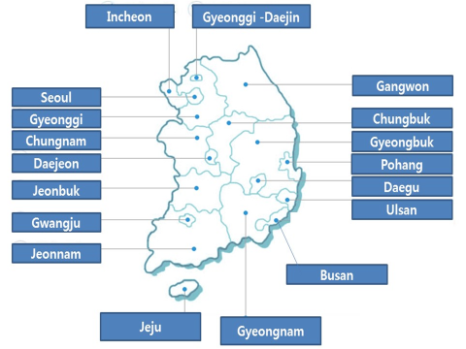
Continued.

Slide 11
Continued.
No. | Names | Year | Location | Specialization Areas | Homepages
1 | Chungnam TP | 1995 | Cheonan-si | Automotive, electronics, bio, display, information & video | http://www.ctp.or.kr/
2 | Gyeonggi TP | 1997 | Ansan-si | ICT, automotive, robot, bio-tech | http://www.gtp.or.kr/
3 | Gwangju TP | 1997 | Gwangju-si | Automotive, bio-materials, electronics, robot, 3D | http://www.gjtp.or.kr/
4 | Daegu TP | 1998 | Daegu-si | Nano, mobile, bio-health, Korean medicine | http://www.ttp.org/dtp/DtpMain.dtp
5 | Pohang TP | 1999 | Pohang-si | Metal, energy parts/materials, bio, S/W | http://www.pohangtp.org/
6 | Gyeongnam TP | 2000 | Changwon-si | Intelligent machinery, material/parts, aero-space, ship-building, ICT | http://www,gntp.or.kr/
7 | Gangwon TP | 2002 | Chuncheon-si | New materials, ceramics, energy, bio, | http://www.gwtp.or.kr/
8 | Daejeon TP | 2002 | Daejeon | IT, bio, nano | http://www.daejeontp.or.kr/index.php
9 | Chungbuk TP | 2003 | Cheongju-si | Bio, solar energy, electronics, machinery, semi-conductor | http://www.cbtp.or.kr/
10 | Jeonnam TP | 2003 | Suncheon-si | New materials, ceramics, laser, polymer | http://www.jntp.or.kr/
11 | Ulsan TP | 2003 | Ulsan-si | Chemical, auto parts | http://www.utp.or.kr/
12 | Seoul TP | 2004 | Seoul | Microsystem packaging, next generation packaging, | http://www.seoultp.or.kr/
13 | Gyeongbuk TP | 2006 | Gyeongsan-si | Digital parts, energy, fabrication,bio, mobile | http://www.ktp.or.kr/
14 | Jeonbuk TP | 2007 | Jeonju-si | Automotive, machinery, green energy, foods, new materials | http://www.jbtp.or.kr/
15 | Incheon TP | 2010 | Incheon-si | Auto parts, nano-materials, bio-industry | http://www.itp.or.kr/
16 | Busan TP | 2010 | Busan-si | Intelligent machinery, precision parts, die-casting/furnace, digital contents, bio-health, | http://www.btp.or.kr/
17 | Jeju TP | 2011 | Jehu-si | bio-convergence, marine bio | http://www.jejutp.or.kr/index.htm
18 | Gyeonggi-Daejin TP | 2014 | Pocheon-si | Environment | http://gdtp.or.kr/index.php

Slide 12
Continued.
The mission and goal of techno-park in Korea
    Primarily placed on the regional economic development,
    Techno-park as an innovation hub of the region.
    Sizable investment has been made to build 18 techno-parks across the country.
Government enacted a special law for development and support of the techno-park,
    Act on special cases concerning support of techno-parks.

Slide 13
A Case Study: Chungnam Techno Park
1,538 machines
400 member companies
14,268 cases
183 startups incubated
Sales : 121 million dollars
Employment : 1,825
Common
Equipment
2,342 pre-engineering training
Hiring promotion : 274 persons
Business
Incubation
Education/
Training
Integrated
Business
Support
Joint R&D
Photo-voltaic test-bed project
2nd battery R&D
Veterinary medicinal product hub
Technologies transfer : 62
Annual conference &
exhibition
Integrated supports :
marketing/technology
market/consulting, etc.
Networking
Open innovation networking : 9,930 participants
Spatial proximity hub, “Chungnam Tech-Biz Zone”
Community networking : local universities and researchers

Slide 14
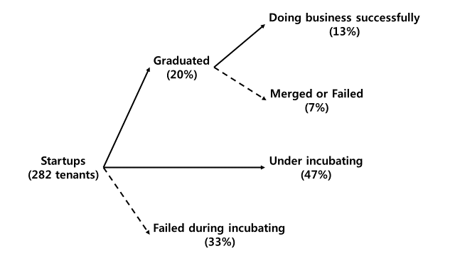
Overall performance: incubation
Period : 2000~2009

Slide 15
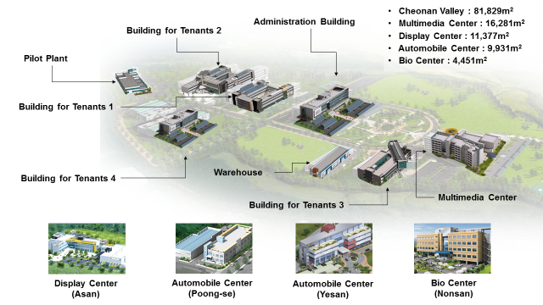
Campus plan

Slide 16
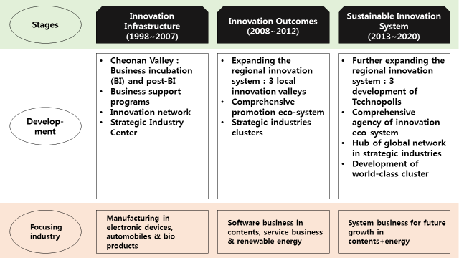
Development roadmaps

Slide 17
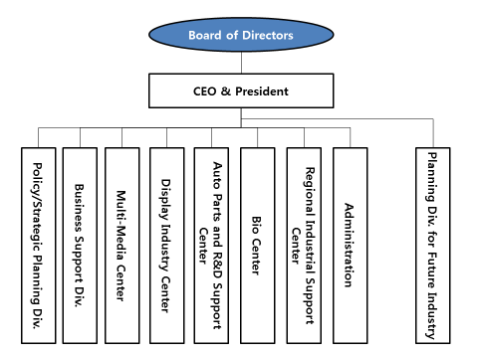
Organization

Slide 18
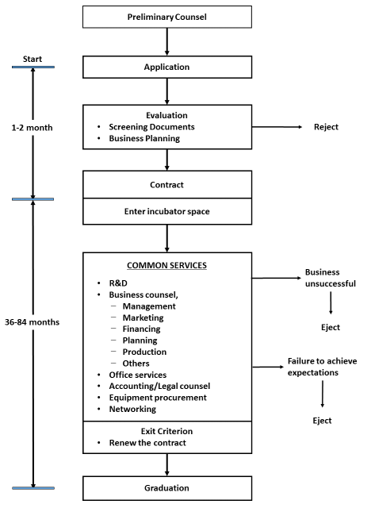
Major Functions (MF) : Incubation

Slide 19
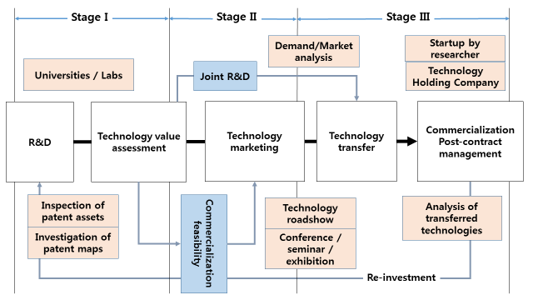
MFs : Technology Transfer and Commercialization

Slide 20
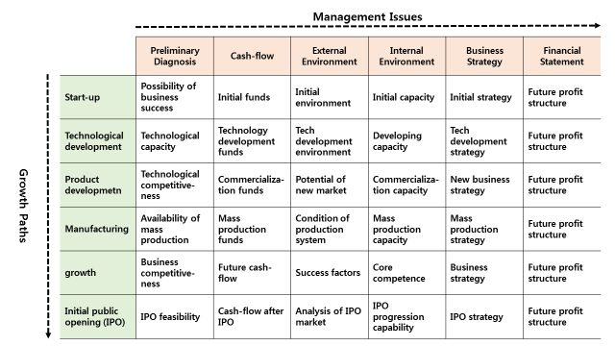
MFs : Business Support Services

Slide 21
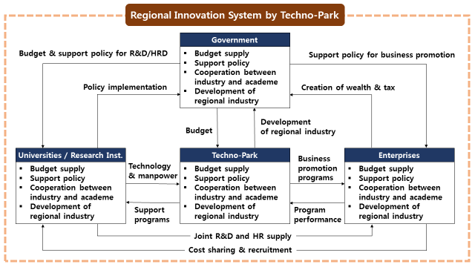
MFs : CTP & RIS

Slide 22
Assessment of Bulgarian Innovation System
Variables | Units | 2014
GDP | € in bn | 42.1
Exports | € in bn | 22.1
Net FDI | % of GDP | 3.2
GDP growth | % | 1.7
Unemployment | % | 10.6
Inflation rate | % | -1.6
Government deficit | % of GDP | -1.5
Government debt | % of GDP | 18.9
Current account balance | % of GDP | 0.0
Long-term credit ratings
Moody’s | Baa2 stable
S&P | BB+ stable
Fitch | BBB- stable

Slide 23
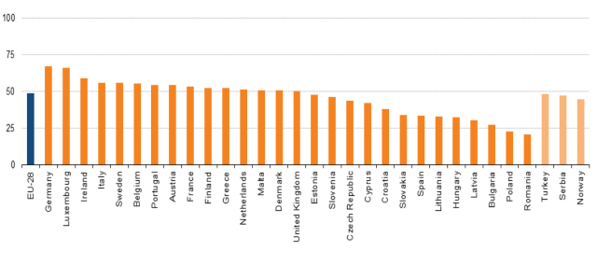
Share of innovative enterprises, 2010–12 (% of all enterprises)

Slide 24
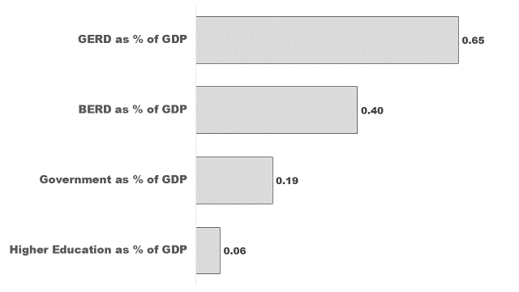
R&D Investment in Bulgaria: 2013

Slide 25
Patents granted
USPTO
 | 2007 | 2008 | 2009 | 2010 | 2011
Bulgaria | 6 | 16 | 36 | 58 | 43
Hungary | 47 | 66 | 46 | 91 | 100
Romania | 11 | 12 | 8 | 16 | 34
Turkey | 19 | 16 | 19 | 29 | 41
Croatia | 15 | 14 | 16 | 9 | 16
Finland | 850 | 824 | 864 | 1143 | 951
EPO
 | 2007 | 2008 | 2009 | 2010 | 2011
Bulgaria | 0.8 | 0.5 | 0.7 | 0.4 | 1.1
Hungary | 3.5 | 4.8 | 3.8 | 5.8 | 4.6
Romania | 0.2 | 0.3 | 0.2 | 0.1 | 0.1
Turkey | 0.5 | 0.7 | 0.8 | 1.2 | 1.3
Croatia | 3.2 | 2.9 | 3.4 | 2.3 | 1.1
Finland | 144 | 154.3 | 124.3 | 126.6 | 109

Slide 26
Global Innovation Index (2015)
 | Index (Score 0~100, or value) | Rank
Global Innovation Index | 42.2 | 39
Innovation Output Sub-Index | 38.2 | 35
Innovation Input Sub-Index | 46.1 | 49
Innovation Efficiency Ratio | 0.8 | 21
By Factors
Institutions | 69.7 | 45
Human capital & research | 32.2 | 58
Infrastructure | 43.3 | 53
Market sophistication | 48.9 | 61
Business sophistication | 36.4 | 60
Knowledge & technology outputs | 27.8 | 102
Creative outputs | 41.1 | 34

Slide 27
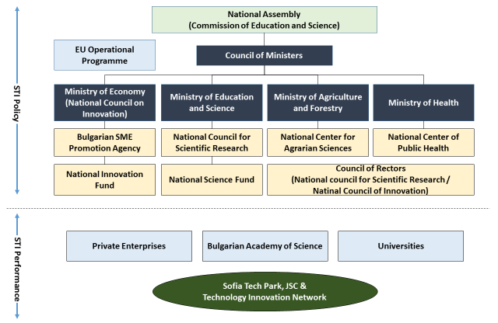
STI Governance

Slide 28
Bulgarian Academy of Science

Slide 29
SWOT Analysis
STRENGTH | WEAKNESS
High share of university graduates Tradition in the fundamental research Highly qualified researchers in the field of physics, chemistry, computer technologies and biotechnologies A member of EU Government’s awareness of the importance of STI development Inflows of FDI | Inefficiency of STI governance for coordin- ation of horizontal issues: lack of effective mechanisms for priority setting, and no integration between the research and inno- vation policy at the national level Low shares of GERD & BERD/GDP Limited business-academia cooperation Brain drain and aging of highly qualified professors and researchers Low GDP share of manufacturing industry and weak industrial ecosystem
OPPORTUNITIES | THREATS
Innovation and entrepreneurial culture of the young generation Bulgarian Diaspora scientists and potential of brain circulation Increasing global research collaboration trends and open innovation | Opportunities for qualified researchers to work abroad with better conditions Rapid change in global STI environment Acceleration of the cycle of technological innovation Deepening globalization and competition.

Slide 30
Sofia Tech Park and TIN
The objectives for developing STP/TIN were to:
    Strengthen the competitiveness of science and entrepreneurship in Bulgaria by improving the exchange of knowledge between academia and the business community.
    Become a platform for the development of start-up companies and innovative ideas.
    Accelerate the process of commercialization of research.
The key components of STP/TIN are:
    A laboratory complex consisting of 11 on-site laboratories in the fields of ICT, life sciences and energy,
    An incubator hosting innovative startup and spin-off companies,
    A forum hosting R&D&I events; international and national.
    A Museum – the Experimentarium

Slide 31
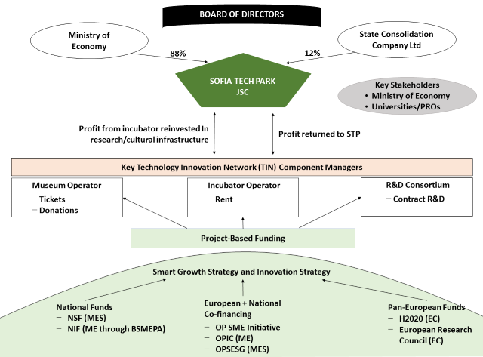
STP/TIN : Operational Framework

Slide 32
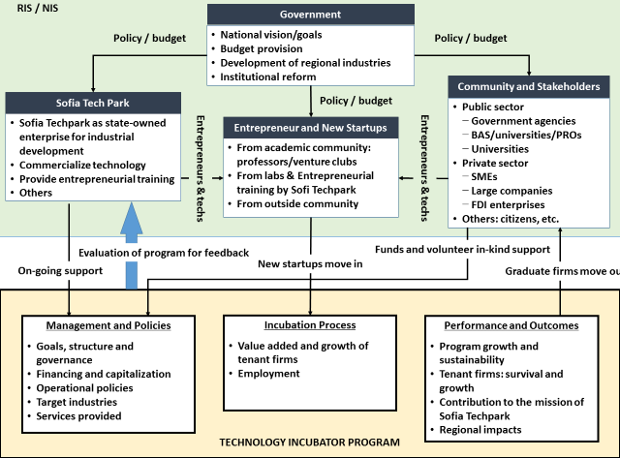
A Conceptual Model of STP/TIN : Incubation

Slide 33
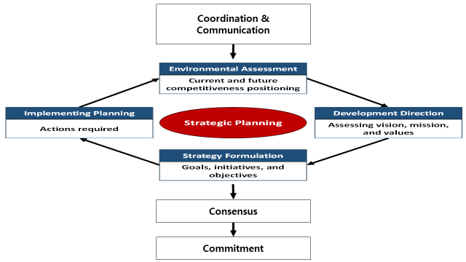
Process of Planning

Slide 34
Issues to be considered in Planning
Vision / Goals & objectives / Direction of development / Strategies
Assessment of STI activity/environment, and RIS/NIS
    Macro-economic analysis/framework condition
    industrial analysis
    STI capacity: university, research institute, enterprise, and RIS/NIS, etc.
Analysis of national strategies, including Bulgaria 2020 and Smart Specialization Strategy, etc.
Structure and governance
    Structured process of decision-making
    Coordination of horizontal issues
    Priority setting
Scope of STP/TIN business
    R&D
    Business incubation
    Technology transfer and commercialization
    Others

Slide 35
Continued.
Technology incubation strategy
    Pre-incubation
    In-wall incubation
    Out-wall incubation
    Post-incubation: exit strategy (M&A Strategy, registration of stock market, etc.)
    Business support programs
        Value chains of startups
        Contact points/program for enterprises with experts
        Network-learning programs
        Technology management programs for CEOs
Technology transfer and commercialization
    Technology Transfer Center (TTC)
    Technology Licensing Office (TLO)
    Technology Holdings Company (THC)

Slide 36
Continued.
Regional/national innovation system
    Concept of regional innovation platform
    STP/TIN as a hub of RIS/NIS
    Requirement of regional/national innovation ecology
    Techpark network at Bulgaria and global level
    Time table and budget
        Time schedule of each program
        Funding schemes for each program

Slide 37
Suggestions in management and policies
Medium- and long-term development plan of the Sofia Tech Park
    Development roadmaps, including programs/activities, infrastructure, research and production facilities, and other
    Linkage between the plan and the national strategies
Incubation
    Entry criterion: business plan, financial state, and technological potential
    Recruit of tenant startups
    Office provision
R&D
    Securing R&D fund for utilizing 20 per cent of labs capacity
    Joint R&D: linking startups, labs, university, PROs and others
    Management plan of R&D projects

Slide 38
Continued.
Technology transfer and commercialization
    Needs survey for industrial technologies
    Database of technologies to be transferred: stock-taking of patents owned by universities/PROs (or overseas sources)
    Technology marketing plan
Business support programs
    Survey of needs for business support services created by the tenant firms
    Support plan for technology development & commercialization, financing, marketing and networking, etc.
Regional/national innovation system
    Networking between industry, university, PROs and other related institutions in the region
    Network-learning programs in the strategic areas of ICT, life science and energy.
    Plan for public relation: vision, mission, objective and activities of STP/TIN as hub of regional/national innovation system

Slide 39
Continued.
Others
    Establishing “STI policy research unit” in STP/TIN
    Studying institutional reform for innovation-friendly environment
    Promotion for recruiting tenants.

Slide 40
Policy suggestions at the government level
Increase in R&D investment :
    The increase in the government R&D investment will stimulate the private R&D, and hence the STI environment will improve at the national level. The government should keep the target to increase R&D investment to 1.5 per cent by 2020.
Pursuing target-oriented R&D projects :
    The top-down approach is necessary to strengthen the linkage of STI policies to the national strategy such as Bulgaria Horizon 2020 and Smart Specialization, etc. Such policy will eventually increase the technological competitiveness of the industry. This is also a preferable approach to strongly link between research labs and startups.
Implementing R&D management system :
    To increase rationality and transparency, it is necessary to implement R&D management system, in which the evaluation and feedback system plays a central role. In so doing, large-scale R&D could be undertaken to tackle socio-economic issues. R&D management includes technology foresight, planning, budget control, evaluation, and others.

Slide 41
Continued.
Improvement of government policy capacity :
    It is necessary to improve the coordination system for horizontal issues. This also implies a reform of STI governance at the government level. In addition, redesign scientific support instruments to target collaborative and mission oriented research by building the capacity of existing research teams and facilitating the creation of public-private research consortia.
Government leadership for STP development
    Now that the STP seems to be a flagship project to bring technological innovation with modern facilities, the success of STP will signal the RTDI landscape of Bulgaria significantly. The government leadership is essential in developing STP as a hub of innovation network in the region/nation. The Bulgarian government may take account of the STP as a strategic vehicle in economic development.

Slide 42
Thank you!!!

